Slide 1




Agri Human Capital Mini Summit
Keeping your finger on the pulse of your workforce
14 June 2018

Slide 2
Intro
Artificial Intelligence
Mobility/Globalisation/New Behaviours rapidly entering our organisation
Millennials
Online Survey Technology
Conclusion

Slide 3


1. Artificial Intelligence

Slide 4
Definition
The theory and development of computer systems, able to perform tasks, normally require human intelligence, such as visual perception, speech recognition, decision-making, and translation between languages.
Merriam-Webster defines artificial intelligence this way: “A branch of computer science dealing with the simulation of intelligent behaviour in computers; The capability of a machine to imitate intelligent human behaviour”.

Slide 5

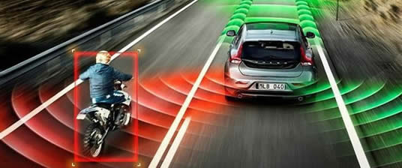
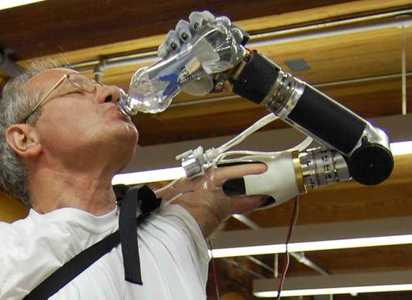
Artificial Intelligence for the future

Slide 6
Artificial Intelligence (AI) is reshaping the way that companies manage their workforce
Talent Acquisition
Onboarding
Training
Performance Analysis
Retention

Slide 7



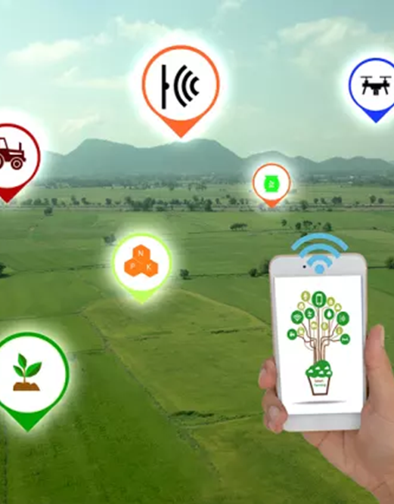
2. Mobility, globalization, and new behaviours rapidly entering our organisation

Slide 8
Globalisation
Language
Culture
Currency
Where you are physically located
Tap into talent anywhere in the world

Slide 9
Mobility
Anytime
Anywhere
Any devices
Applications
Work is not a place you go to,
it is something you carry with you

Slide 10
New behaviours rapidly entering
our organisation
Public lifestyle
Social media
Every aspect of the business behaviour has changed
  Share
  Communicate
  Collaborate platforms
  Teach
  Learn
  Find Information
  Access Technology
  Create content

Slide 11
People analytics
  HR Analytics is the use of people-data in analytical processes to solve business problems. HR Analytics use both people-data, collected by HR systems (e.g. payroll, absence management), and business information (e.g. operations performance data)
  Big data
  Wearable devices
  Cloud computing

Slide 12

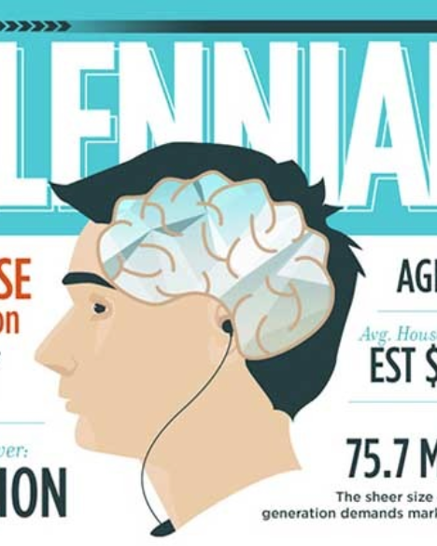
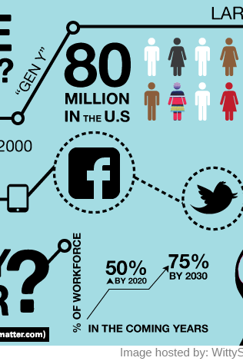
3. Millennials

Slide 13
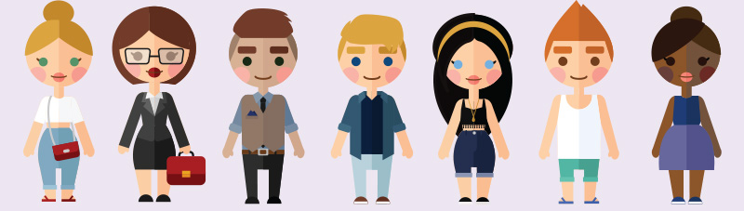
Millennials
What and who are the Millennials?
Why Millennials?
Key qualities of millennials

Slide 14
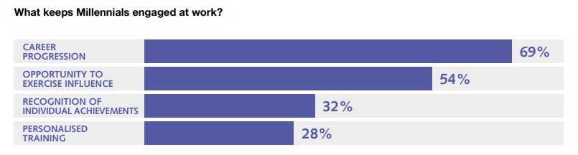
Millennials
How to attract Millennial professionals
What matters most to Millennials when starting a new job?
What does it take to retain Millennial professionals?

Slide 15
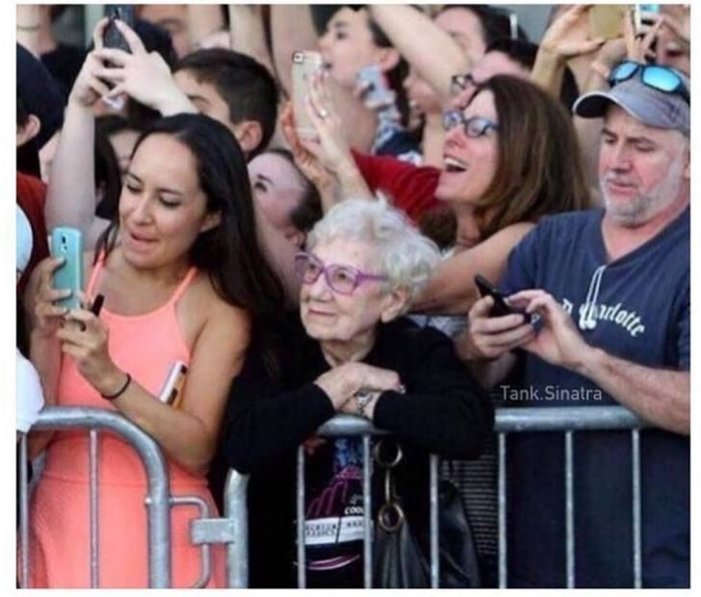
Millennials
How to develop Millennials into future business leaders
What role does technology play in attracting and retaining Millennial professionals?
Tips on managing Millennials

Slide 16
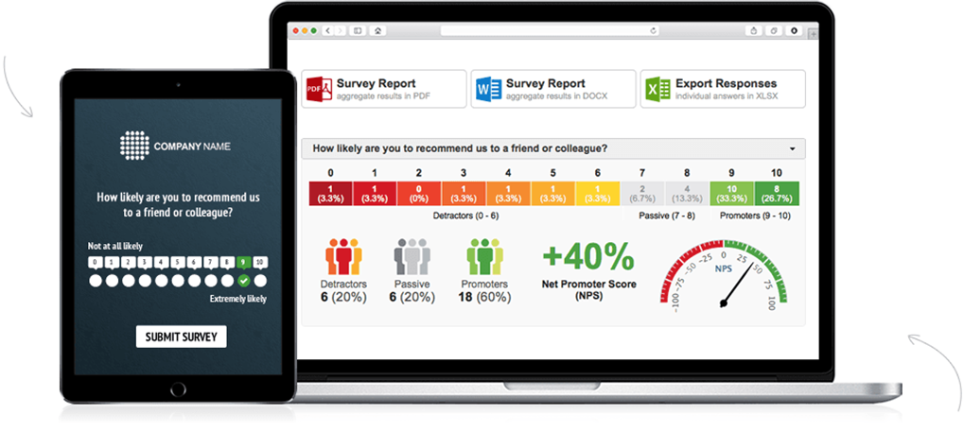


4. Online Survey Technology
Why surveys are important
Advantages of online surveys
Different types of HR surveys
Practical Demonstration: Peritum Survey Technology

Slide 17
Advantages of Online Surveys
Faster
Cheaper
More accurate
Quick to analyse
Easy to use for participants
Easy to use for researchers
Easy to style
More honest
More selective
More flexible

Slide 18
Employees’ & clients’ experiences
Keeping your finger on the pulse
Different types of HR Surveys
  Employee Attitude Surveys
  Employee Opinion Surveys
  Employee Satisfaction Surveys
  Employee Engagement Surveys
  Employee Performance Appraisal
  360 Surveys
  Organizational Assessment Surveys
  Employer Improvement Surveys
  Employee Exit Surveys
  Employee Benefits Surveys
  Professional Development Surveys

Slide 19

Practical Demonstration:
Peritum Survey Technology

Slide 20
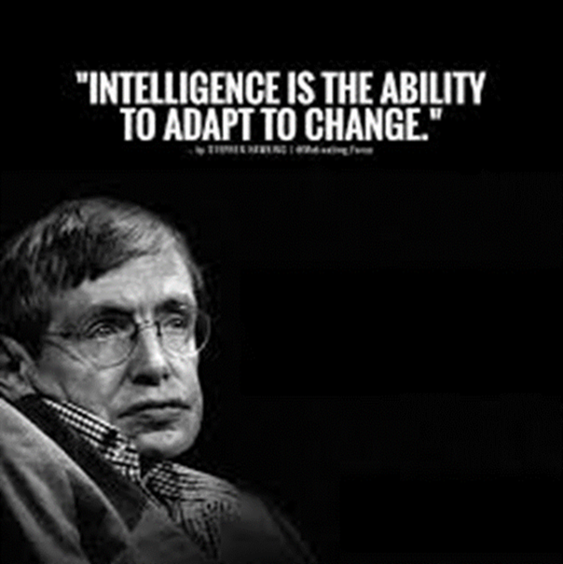
5. Conclusion

